Slide 1
HNDIT1212: System Analysis and Design
Applications of Information Systems

Slide 2
Types of Information Systems
Information systems can be classified in many ways,
Classification by mode of processing
Classification by System Objectives

Slide 3
Classification by mode of processing
Batch processing systems:
The transactions are collected as they occur, but processed periodically, say, once a day or week.
On-line batch systems:
The transaction information is captured by on-line data-entry devices and logged on the system, but it is processed periodically as in batch processing systems.
On-line Real-time systems:
The transaction data capture as well as their processing in order to update records (and generate reports) is carried out in real-time as the transaction is taking place.

Slide 4
Classification by System Objectives Type of information System
Transaction Processing System (TPS)
Management Information System (MIS)
Decision Support System (DSS)
Executive Information System (EIS)
Expert Systems (ES)
Communications and Collaboration Systems
Office Automation System
Geographic Information System (GIS)

Slide 5
The use of information systems by management level.
Executive information system
Strategic Level
Senior Management
Decision support system
Tactical Level
Middle Management
Management information system
Operational Level
Line Management
Transaction processing system
Office automation system

Slide 6
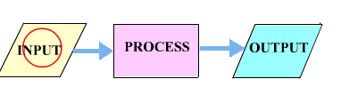
Transaction Processing System (TPS)
Information Systems that capture and process data about business transactions.
Used mainly by operational level employees

Slide 7

Management Information System
MIS is an information system application that provides for management oriented reporting.
lower and middle management can control, organize and plan more effectively and efficiently.

Slide 8
Decision Support System (DSS)
Provides its user with decision-oriented information whenever decision making situation arise.
They are interactive systems that assist a decision maker when faced with unstructured or semi structured business problems.
Interactive computer-based modeling process

Slide 9
Executive Information System (EIS) /Executive Support System(ESS)
An information system designed for top-level managers.
They integrates data from all over the organization into graphical indicators and controls

Slide 10
Executive Information System (EIS)..
ESSs serve to,
indicate issues of importance to the organization
indicate new directions the company may take
help executives monitor the company’s progress

Slide 11
Expert Systems (ES)
An expert system is a programmed decision making information system.
It capture and reproduces the knowledge and expertise of a decision maker and
Simulates the “thinking “ of the expert.

Slide 12
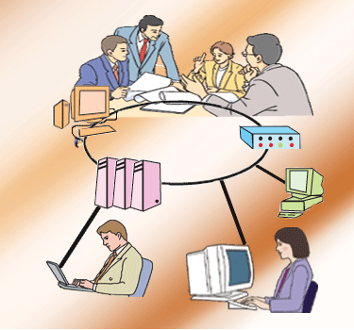
Communications and Collaboration Systems
An IS that enables more effective communications between,
Workers
Partners
Customers
Suppliers
Enhance their ability to collaborate

Slide 13

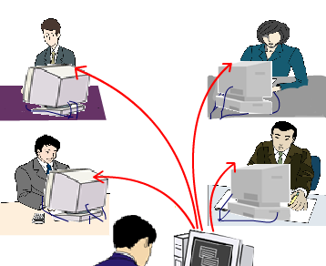
Office Automation System
It supports the wide range of business office activities.
Work group computing
Work group scheduling
E-mail
Electronic document

Slide 14
Geographic Information System (GIS)
A system designed to capture, store, manipulate, analyze, manage, and present all types of spatial or geographical data.

Slide 15
Legacy Systems
Legacy system is an "antiquated" system.
potentially problematic
often run on obsolete hardware
spare parts for such computers become increasingly difficult to obtain
hard to maintain, improve and expand
The designers of the system may have left the organization, leaving no one left to explain how it works.

Slide 16
Upgrading a Legacy System
Many complex legacy systems are yet to be upgraded to new technologies because of
Cost
Skills
People required
Force to change – to reflect new or changing business requirements.
Year 2000 problem (Y2K)
Euro conversion

